Slide 1
Personal Introduction
Valentin Adlgasser

Slide 2
Personal Info
Valentin Adlgasser
17
Eugendorf
2 sisters and 2 brothers
1 dog, 1 cat and 2 tortoises
I work at MIELE

Slide 3
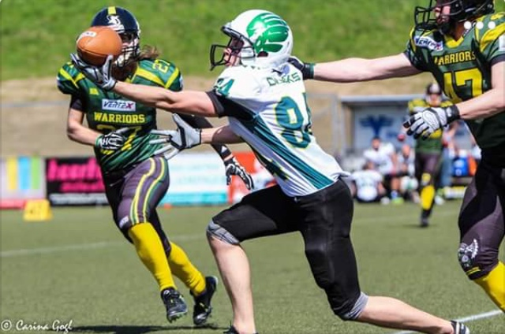
What am I doing in my free time?
Play American Football
Play Golf
Go out with my friends/girlfriend
Watch movies/TV series

Slide 4

School
Elementary School Eugendorf
Bundesgymnasium Seekirchen
Victoria High School Ulverston

Slide 5
Why I work in IT?
Because I always wanted to be able to program
You always get a job
Later I want to work as a Web Developer

Slide 6
Thank you for your attention

